Slide 1
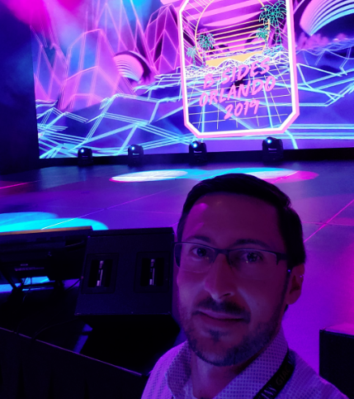

DevOps Exchange 2021: Security Champions
Presented by Rick Payne MSc, CISSP, Security+ , BS-IST, AS-CET, AWS CSA, RHCE, RHCSA
Notes:
Imposter syndrome. My 5th Bsides I committed to speaking at the next.
Could have been presenting familiar concepts much earlier
Go for it! We need you!

Slide 2

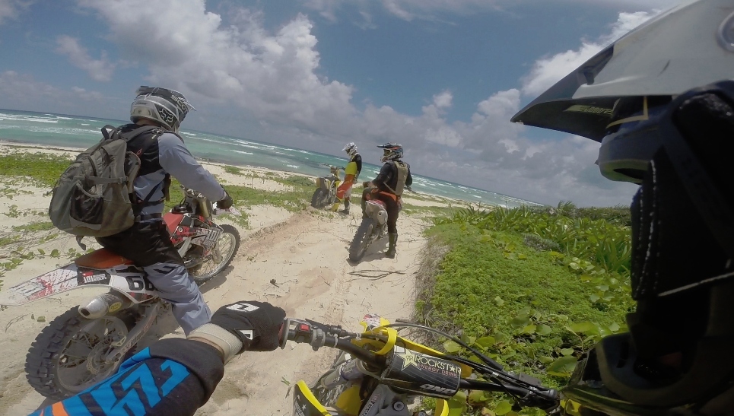
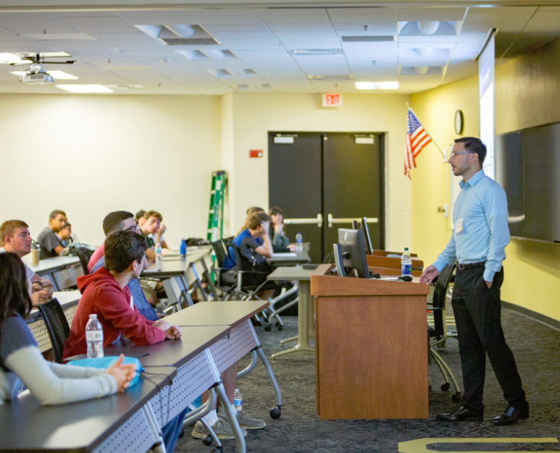
About me
CAREER CONF/PRES EDUCATION
Principal Security Engineer +1 DOX ☺
Staff Security Engineer >35 MSc
Sr. Security Engineer
Chief Security Officer AWS-CSA
Security Architect CISSP
Security Analyst I/II ^^^ BS, AA, Security+, RHCE, RHCSA
System Integration Tech I/II
Manufacturing Test Tech I/II AS-CET
Production Test Intern

Slide 3



Presentation Goals
Security Responsibility Awareness – Who’s role is it anyway?
Maturity Model – Where am I? Where do I need to go?
Actionable – Start securing your systems today!
Notes:
Roles are collapsing in. Follow the code
How mature are you, your team, company? Understand Acceptable Level of Risk
Code to compliance mapping -> Scanning for IDE, AWS, K8s, OS, Container

Slide 4





2021 GitLab DevSecOps Survey
Sec and dev are friendlier, but there is still confusion over who “owns” security, and the finger-pointing game is strong¹
A full 39% of developers feel fully responsible for security in their organizations (up from 28% last year), while 32% said they shared the burden with other teams¹
Dev-centric questions with app-focused answers. What about the Infra & Platform layers?
Notes:
https://about.gitlab.com/developer-survey/
Access keys committed to GitHub?
Maybe some critical vulnerabilities in outdated AMIs
Excessively permissive Administrator IAM role to make a few simple API calls

Slide 5
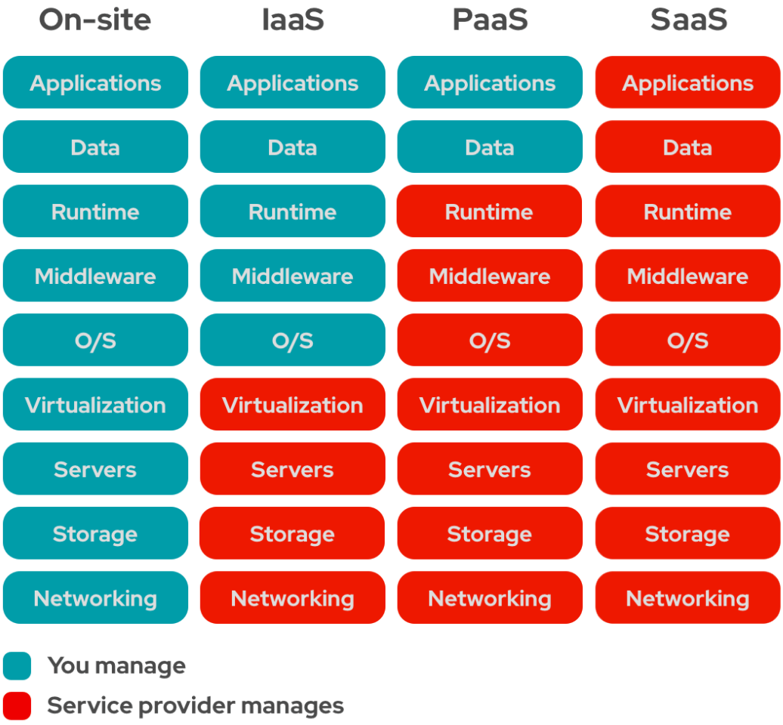
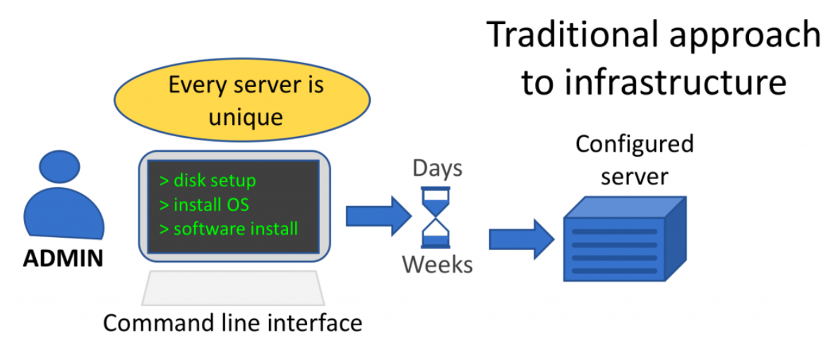
Shifting Left: R&Rs Follow the Code!
Land before time
Notes:
2. Traditional diagram - https://www.thegreengrid.org/en/newsroom/blog/software-development-discipline-reshapes-infrastructure
3. aaS compare diagram https://www.redhat.com/en/topics/cloud-computing/iaas-vs-paas-vs-saas

Slide 6
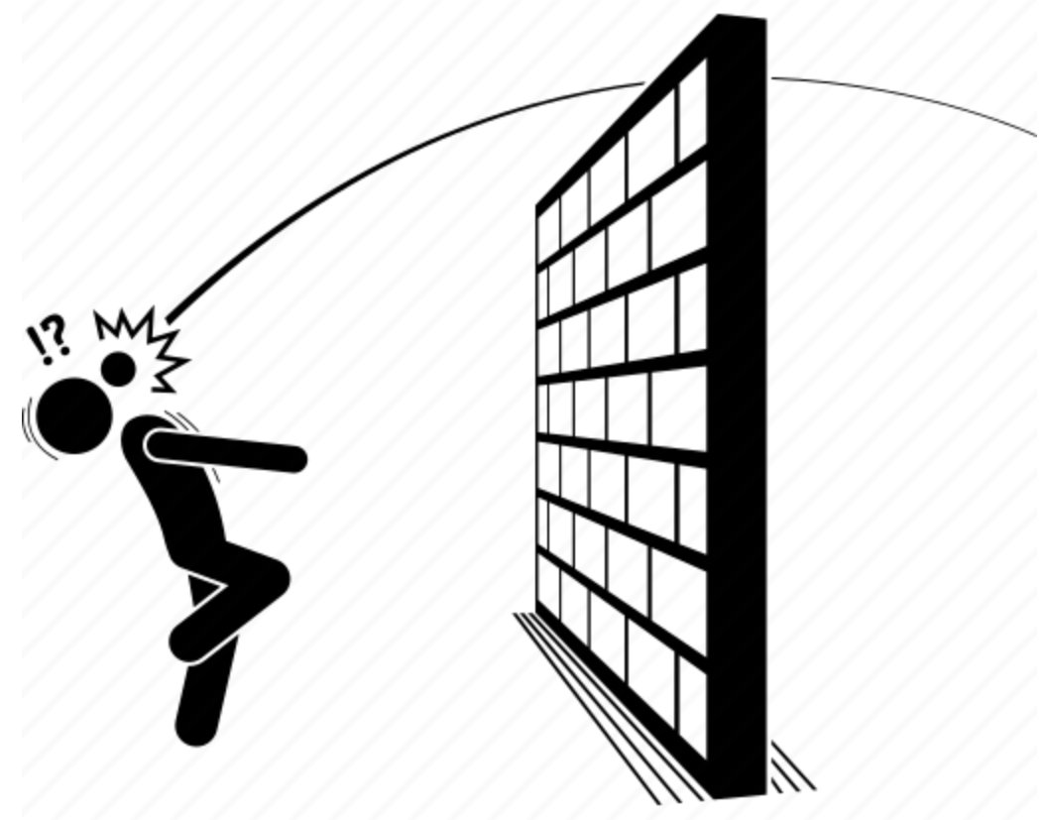




Shifting Left: R&Rs Then -> Now
Requirements / Scan Result Punt -> Security Engineering
Fundamental Human Capacity Problem
1.5 security experts per 100 software engineers²
Day 1 Cybersecurity Debt
Notes:
2. https://www.forbes.com/sites/forbestechcouncil/2021/01/04/a-modern-shift-left-security-approach/
Same concept as bug detection
Integrate security tooling into current frameworks
Quick, feature delivery vs code quality

Slide 7
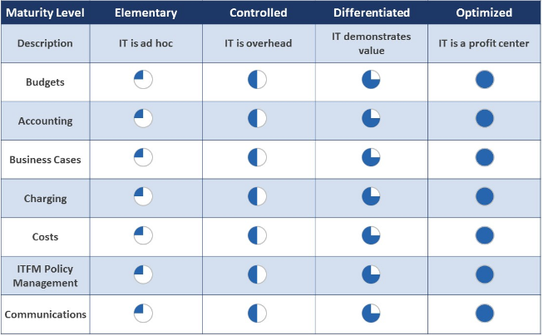
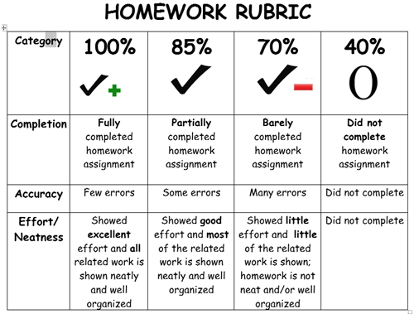
What are Maturity Models?
Essentially, how mature is an organization at a specific objective.
Notes:
Capability report card

Slide 8
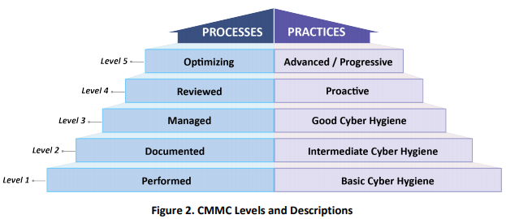
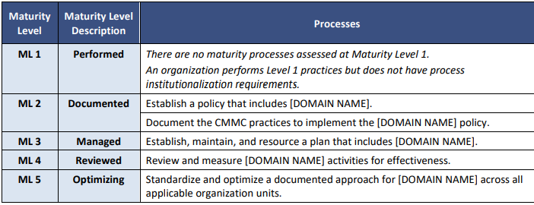
What are Maturity Models?
DoD’s Cybersecurity Maturity Model example

Slide 9
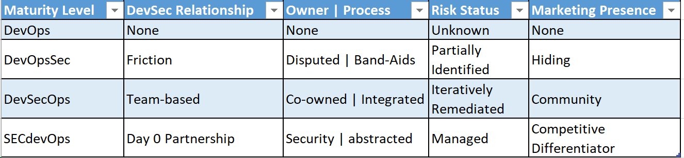
Maturity Models – DevOps -> SECdevOps

Slide 10
Maturity Models – DevOps -> SECdevOps
DevOps
DevOps without security is essentially a product pen test sandbox!
Most default deployments can consist of 100s or >1000s configurations or vulnerabilities
Business perspective -> You can’t acquire or maintain any security certifications

Slide 11
Maturity Models – DevOps -> SECdevOps
DevOpsSec <- Shift left
Security is begrudgingly forced in
Still political friction
Security is chasing production / already released workloads

Slide 12
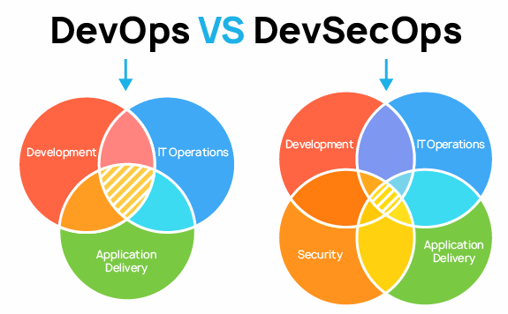
Maturity Models – DevOps -> SECdevOps
DevSecOps <- Shift left
Culture shift:
Roles: We’re a team!
Responsibilities: Every piece of the puzzle has a security layer with support

Slide 13
Maturity Models – DevOps -> SECdevOps
SECdevOps
Security is at the forefront of everything
Project kickoffs
Design reviews
Devs can now focus on secure code and update support as Infra & Platform are invisible. Security becomes FREE!
Security features are equally or more important than dev

Slide 14
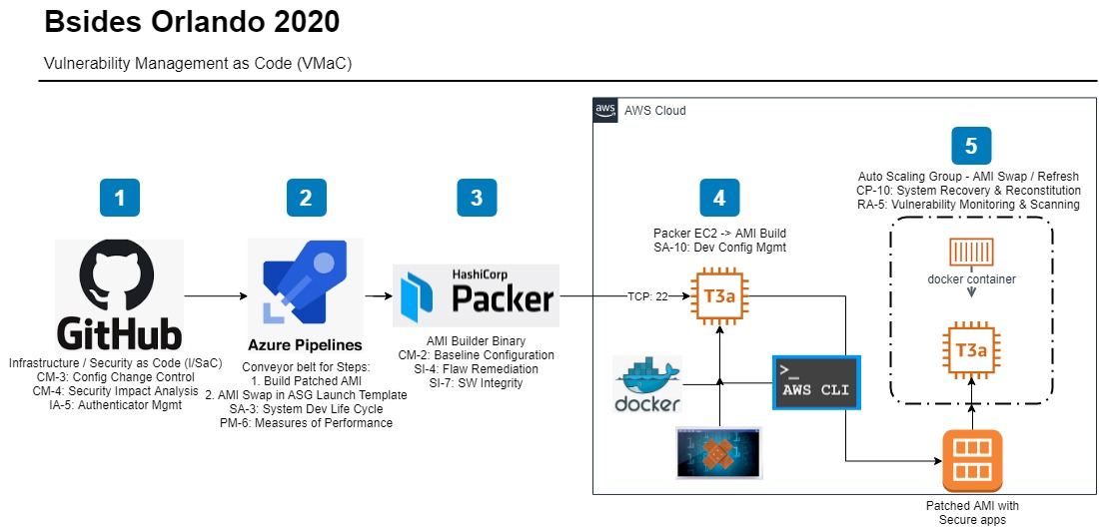
Demo - Lightweight, Conceptual
Vulnerability Management as Code (VMaC) solution overview
Notes:
Immutable as Code =
Contingency Planning & Disaster Recovery
Configuration Mgmt
Vuln Mgmt
Least-Privilege IAM Role

Slide 15
Demo – IDE Scanning – The Source
Visual Studio Code – Snyk Vulnerability Scanner https://marketplace.visualstudio.com/items?itemName=snyk-security.snyk-vulnerability-scanner
Visual Studio Code – Snyk Vuln Cost https://marketplace.visualstudio.com/items?itemName=snyk-security.vscode-vuln-cost

Slide 16
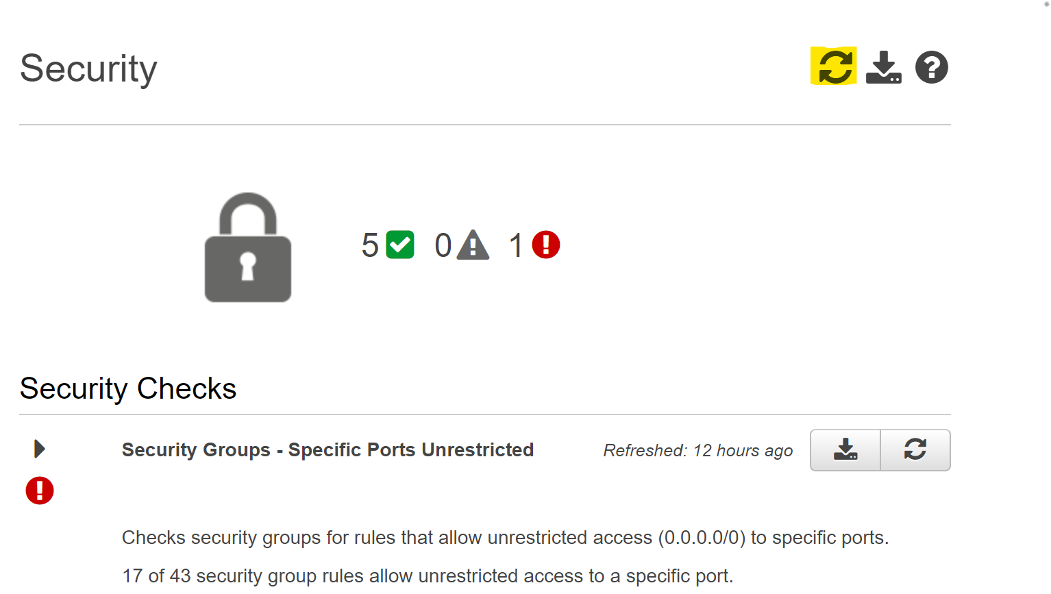
Demo – AWS Trusted Advisor
Vulnerability Management as Code (VMaC) solution overview
Notes:
AWS TA -> Refresh
Unrestricted SGs
Public EBS & RDS snapshots, S3 buckets
Root MFA

Slide 17
Demo – DoD Secure Configuration Guidance
STIG Viewer - https://public.cyber.mil/stigs/stig-viewing-tools/
STIG Library - https://public.cyber.mil/stigs/compilations/
Kubernetes: 93 (15 Sev 1 e.g. The Kubernetes Kubelet must have the read-only port flag disabled.)
Server 2019: 304 (33 Sev 1 e.g. Windows Server 2019 must be configured to prevent the storage of the LAN Manager hash of passwords.)
Red Hat 8: 343 (18 Sev 1 e.g. The root account must be the only account having unrestricted access to the RHEL 8 system.)
Ubuntu 20: 185 (11 Sev 1 e.g. The Ubuntu operating system must not have the telnet package installed.)
MS SQL 2016: 144 (12 Sev 1 e.g. When using command-line tools such as SQLCMD in a mixed-mode authentication environment, users must use a logon method that does not expose the password.)
Apache 2.4: 75 (5 Sev 1 e.g. The account used to run the Apache web server must not have a valid login shell and password defined.)
1144 total, 94 Sev 1
NIST 800-53r4 – Table H-1 to ISO 27001 - https://csrc.nist.gov/publications/detail/sp/800-53/rev-4/final
Notes:
SCAP Compliance Checker?

Slide 18
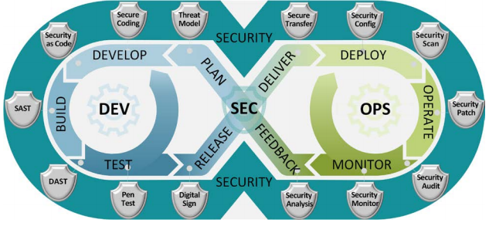
Demo – DoD Secure Configuration Guidance
Free OS Configuration Scanning - https://public.cyber.mil/stigs/scap/
Container Hardening Guide V1R1 - https://software.af.mil/wp-content/uploads/2021/03/2020_Oct_-Final-DevSecOps-Enterprise-Container-Hardening-Guide-1.1-Public-Release.pdf
DevSecOps Reference Architecture - https://dodcio.defense.gov/Portals/0/Documents/DoD%20Enterprise%20DevSecOps%20Reference%20Design%20v1.0_Public%20Release.pdf?ver=2019-09-26-115824-583
Notes:
SCAP Compliance Checker?

Slide 19
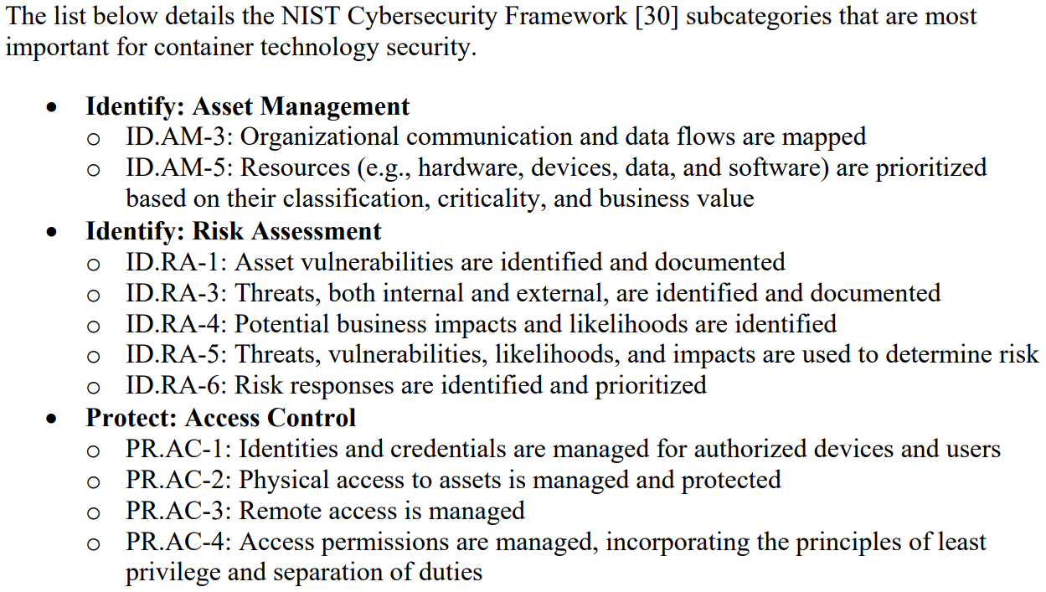
Demo – NIST Container Security
Application Container Security Guide - https://nvlpubs.nist.gov/nistpubs/SpecialPublications/NIST.SP.800-190.pdf
Notes:
Mapped to Cybersecurity Framework

Slide 20
Demo – K8s Secure Configuration Guidance
DoD K8s STIG Export
AWS EKS Security - https://docs.aws.amazon.com/eks/latest/userguide/security.html
EKS Scanning with kube-bench - https://aws.amazon.com/blogs/containers/introducing-cis-amazon-eks-benchmark/
42m00s - https://www.eksworkshop.com/intermediate/300_cis_eks_benchmark/

Slide 21
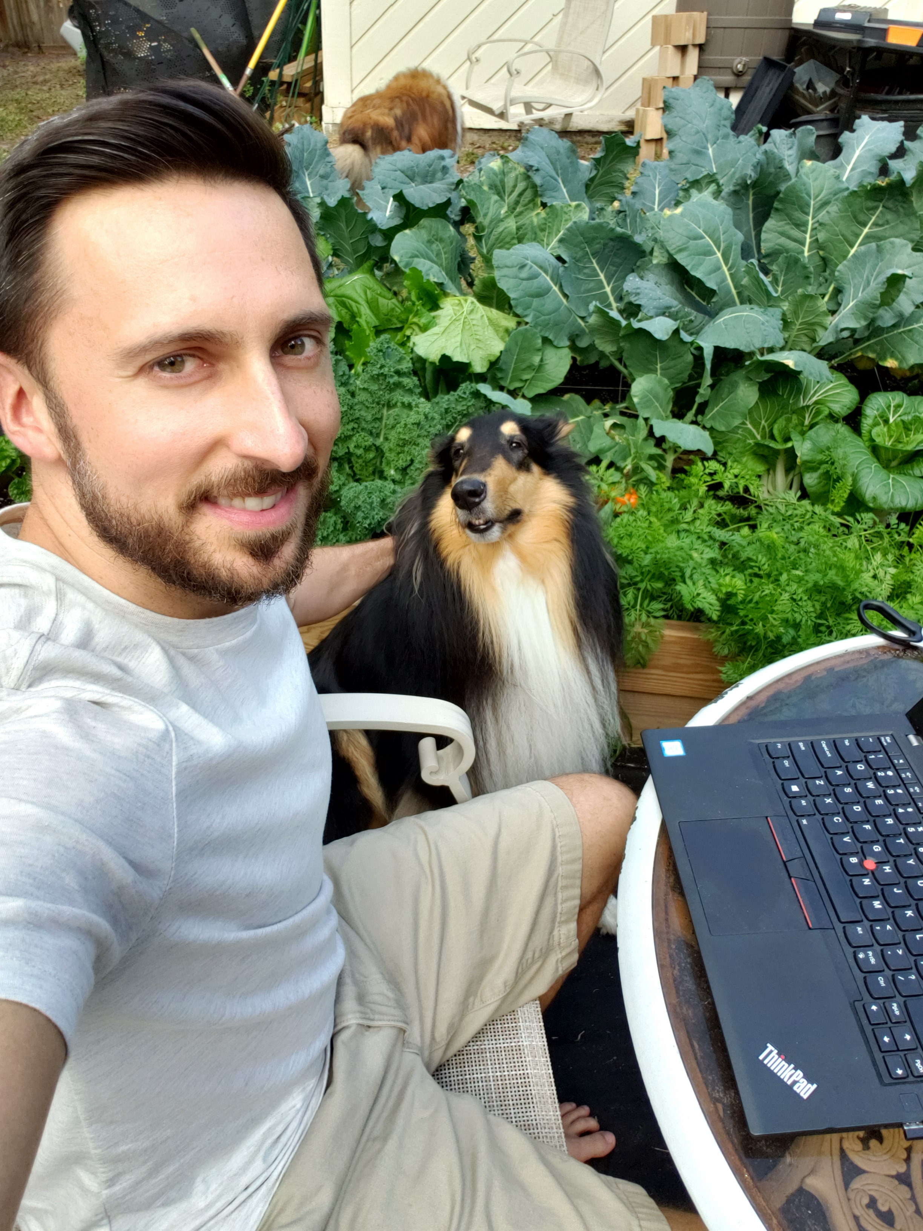
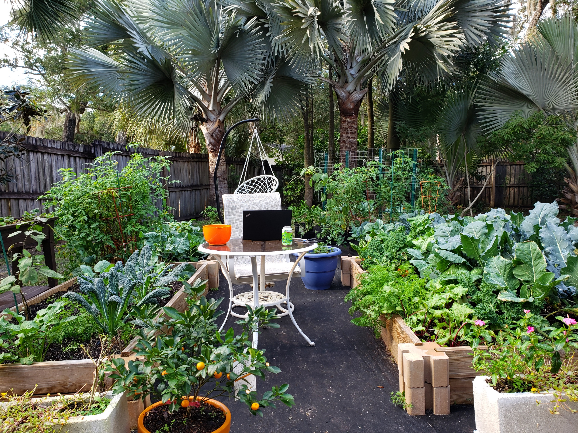
Last but not least, take care of yourself!

Slide 22
Q&A / References
GitHub - https://github.com/rickpayne929/presentations
Event Page - https://www.meetup.com/DOXNYC/events/278299834/
DoD Cybersecurity Maturity Model Certification (CMMC) - https://www.acq.osd.mil/cmmc/docs/CMMC_ModelMain_V1.02_20200318.pdf
DoD DevSecOps Reference Design - https://dodcio.defense.gov/Portals/0/Documents/DoD%20Enterprise%20DevSecOps%20Reference%20Design%20v1.0_Public%20Release.pdf?ver=2019-09-26-115824-583

Slide 23
Q&A / References
GitLab - 2021 Global DevSecOps Survey https://about.gitlab.com/developer-survey/
IBM – IaC https://www.thegreengrid.org/en/newsroom/blog/software-development-discipline-reshapes-infrastructure
RedHat - IaaS vs PaaS vs SaaS https://www.redhat.com/en/topics/cloud-computing/iaas-vs-paas-vs-saas
Forbes – Modern Shift Left Security https://www.forbes.com/sites/forbestechcouncil/2021/01/04/a-modern-shift-left-security-approach/

